Slide 1

Cryptography
Cybersecurity internship
Week 3 presentation
Intern: Assil Bzal

Slide 2
Outline
Introduction to cryptography
Symmetric cryptography
Asymmetric cryptography
How to protect yourself from MITMA
Browser security

Slide 3

What is cryptography?
Cryptography is writing in a hidden way.
Cryptography ensures the confidentiality, authenticity, and integrity of information.
I want to send a message to Bob without any hacker knowing it. How would I do it ?
Alice
Bob

Slide 4
Encryption
It is the process of converting a readable text (plain text) to something locked that contains an unreadable message (cipher text).
Oh great!!
But how would I lock it?
There’s several ways to lock your message.
Let’s show them all to you and then you’ll decide which one suits you better.

Slide 5
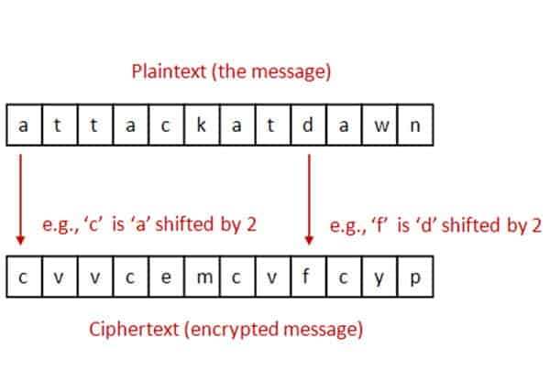
A. Caeser Cipher
Imagine that you want to send “hello” to Bob, this is what you would do.
You shift each letter by 2.
Hello=jgnnq
Here’s another example shown in the
picture

Slide 6
B. Vernam Cipher
Now let’s talk binary.
Imagine this is your binary message that you want to send:
m= 001101110
This is your key:
K= 010100101
This is how you should cipher:
0+1=1
1+0=1
1+1=0
001101110
+ 010100101
011001011

Slide 7
C. Block encryption
Not only you can encrypt by message, it can also happen by block.
Block encrypting algorithms:
DES: Data Encryption System
AES: Advanced Encryption System
CBC: Cipher Block Chaining

Slide 8
1. DES
Operates on 64-bit blocks of data using a 56-bit key.
Was widely used in the 1970s–1990s but is now considered insecure due to its short key length.

Slide 9
2. AES
Works on 128-bit blocks of data and supports key sizes of 128, 192, or 256 bits.
Considered highly secure and efficient, widely used in modern applications like HTTPS, VPNs, and file encryption.
Key points:
Replaced DES and 3DES due to stronger security.

Slide 10
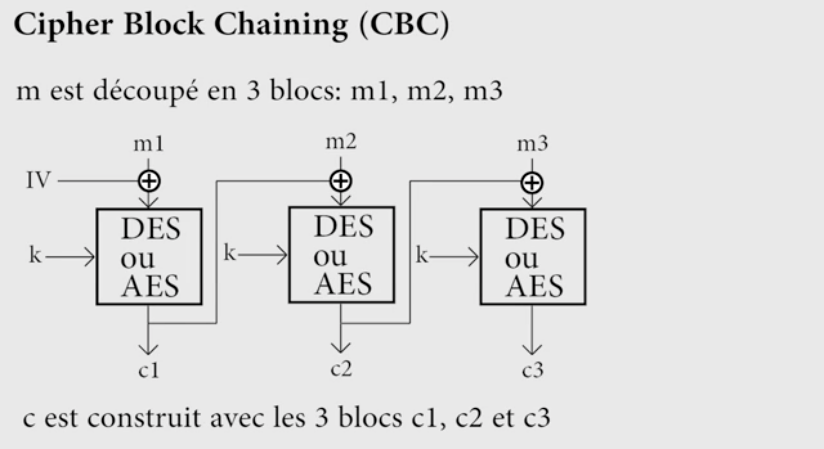
3. CBC
It is a mode of operation for block ciphers like DES or AES.
Each plaintext block is XORed with the previous ciphertext block before being encrypted.
The first block uses an Initialization Vector (IV) to ensure uniqueness.

Slide 11
You may notice that all of the previously explained algorithms are using only one key.
Symmetric Cryptography

Slide 12
Asymmetric Cryptography
Now let’s dig into a more advanced way to cipher your messages.
We use 2 keys, 1 for encrypting and the other for decrypting.
But what’s the difference between these 2 keys?
Each one of you has a public key and a secret one.
The public key, everyone knows about it.
The secret key, or the private key, is never shared with
anyone, it has to be completely hidden.

Slide 13
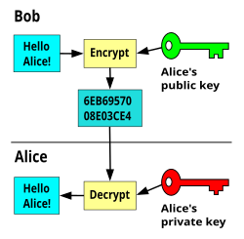
How does it work?
We encrypt with the public key of the receiver.
The receiver decrypts with his own private key.

Slide 14
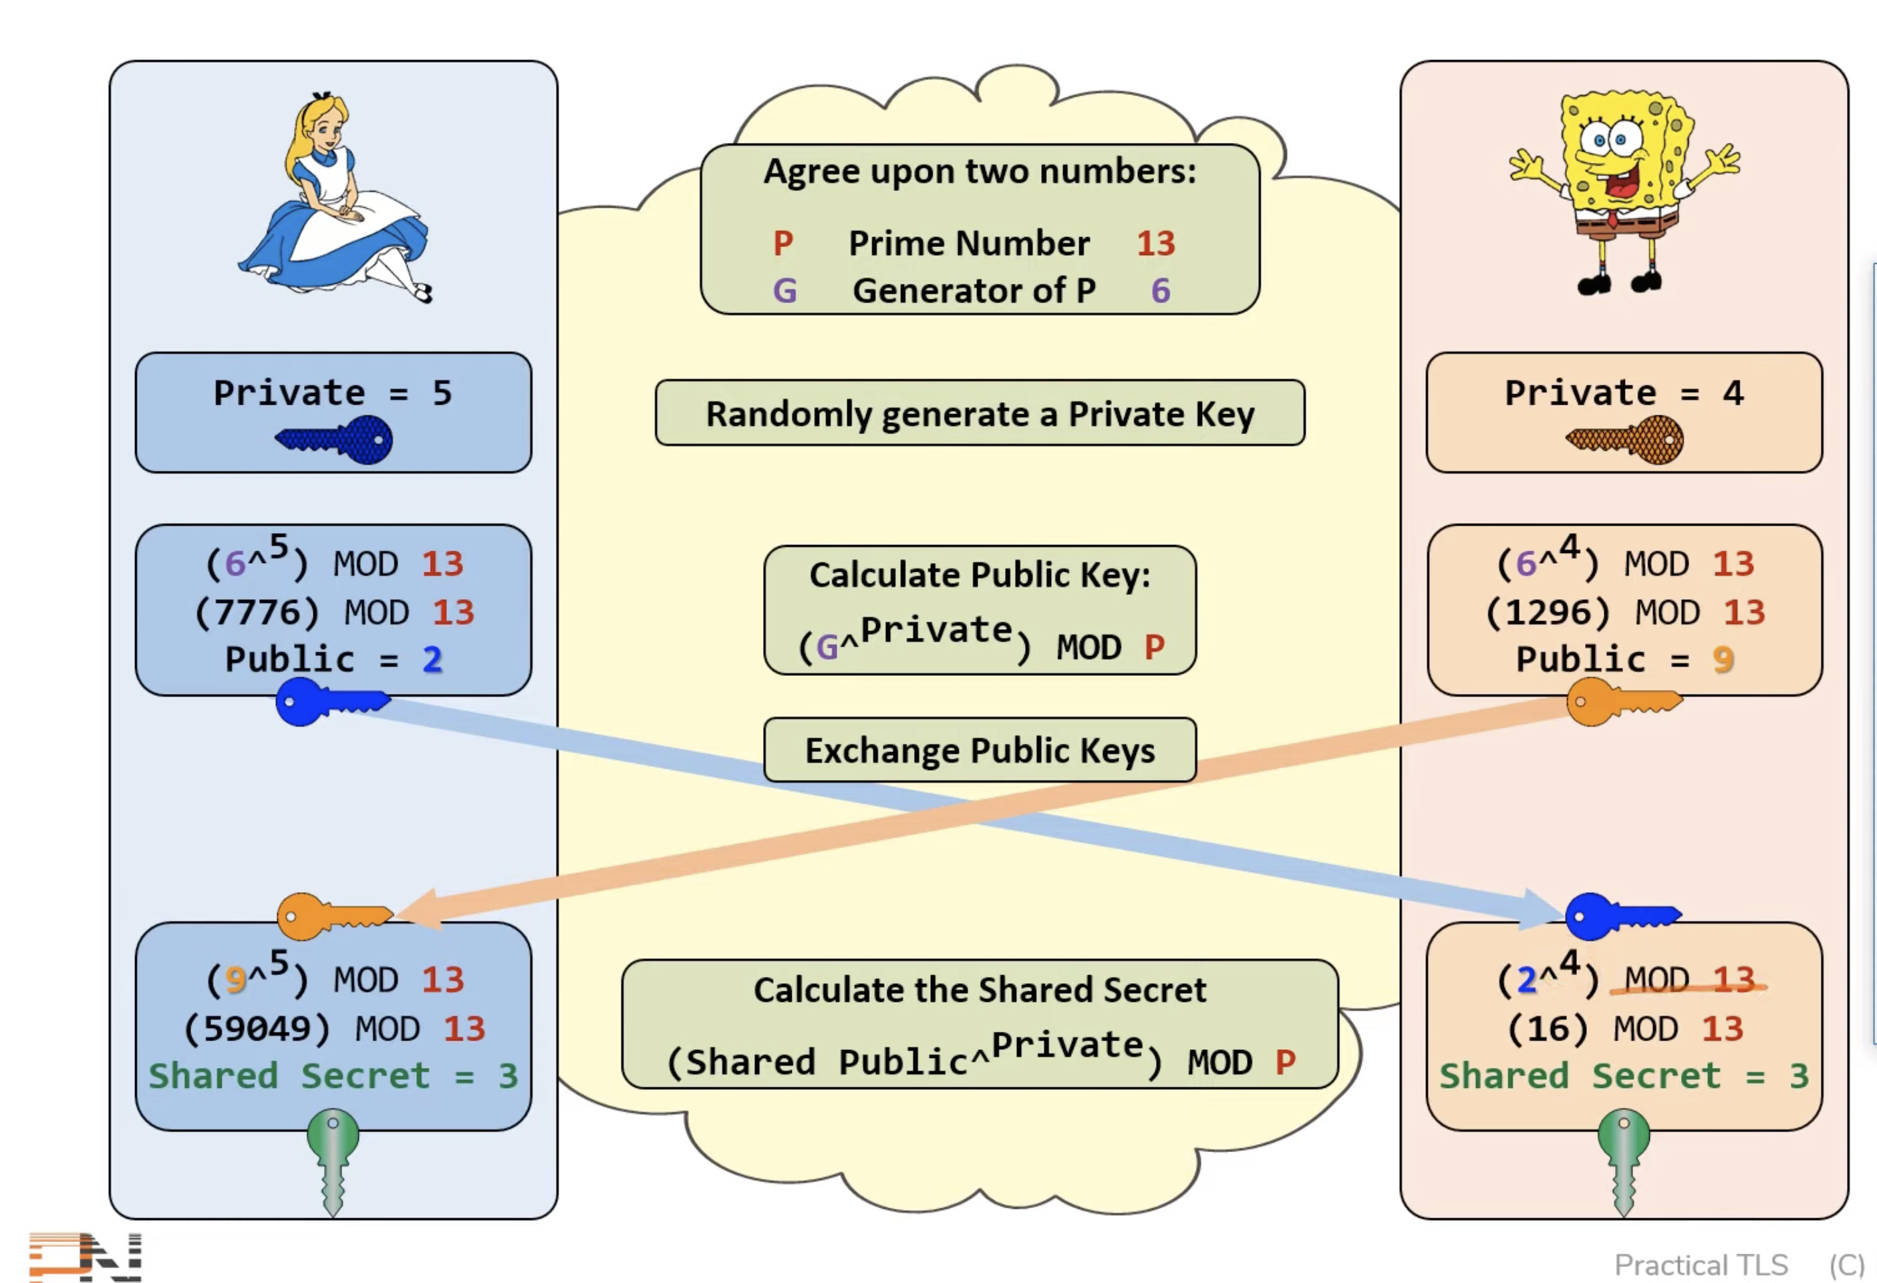
Diffie Hellman’s algorithm
A method for two parties to securely share a secret key over an insecure channel.

Slide 15
But what if the hacker got his hands on the public key, updated it, and then the code go encrypted by the hacker’s public key? This way he can decrypt the message easily!!!!

Slide 16
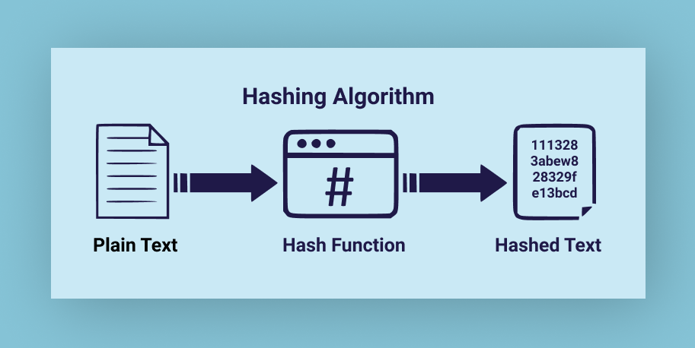
Cryptographic hash function
A function that takes an input (message) and produces a fixed-size string of bytes (the hash or digest).
The output is unique for different inputs (with very high probability).

Slide 17
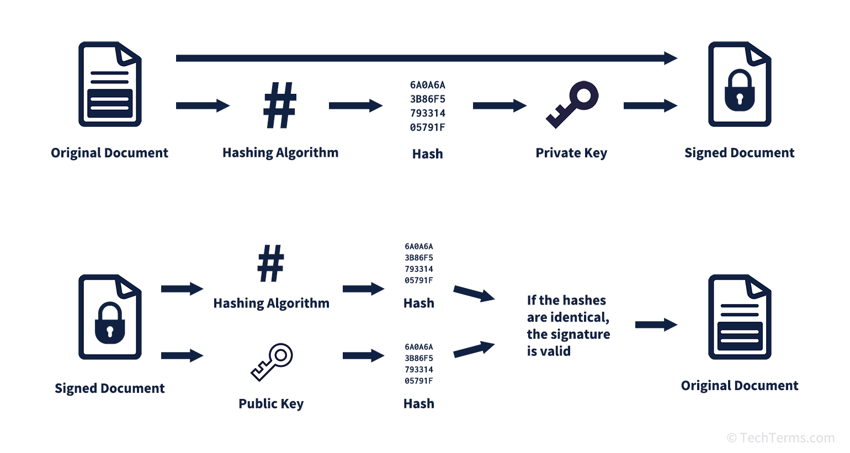
Digital Signature
A digital signature is a cryptographic technique used to verify the authenticity and integrity of a message, document, or software.
The sender generates a hash of the message.
The hash is encrypted with the sender’s private key → this forms the digital signature.
The recipient decrypts the signature with the sender’s public key and compares the hash with the received message.

Slide 18
But what if we combined both ways of cryptography, symmetric and asymmetric cryptography? Wouldn’t be more secure?

Slide 19
Cryptosystems
It’s a combination of both, symmetric and asymmetric cryptography.
It is a structured collection of algorithms, keys, and procedures used to provide secure communication.
It ensures confidentiality, integrity, authenticity, and non-repudiation of information.
Encryption:
hash+private key= signature
We encrypt the result with the recipient’s public key
The recipient decrypts with his own private key then verifies the sender’s signature with the sender’s public key
If v=1 → verified
This way we ensure authenticity, confidentiality, integrity.

Slide 20
How to protect yourself from Man-in-the-middle attacks?
There are three concepts in cybersecurity:
Short authenticated strings (SAS)
Web of trust
Chain of trust

Slide 21
1. SAS
I want to send a message to Bob without any hacker knowing it. How would I do it ?
Send me the hash via the secret tunnel
Alice
Bob
Hash

Slide 22
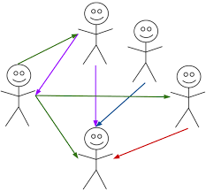
2. Web of trust
Note:
A public key is valid in 3 cases:
If it’s signed by a person who has a high level of trust.
Signed by at least 3 people with high level of marginal
trust.
3. The way to the public key is smaller than 5 people

Slide 23
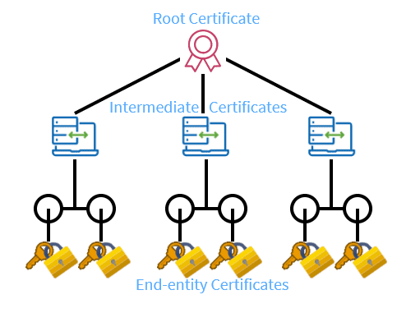
3. Chain of trust
A Chain of Trust is a hierarchical model in Public Key Infrastructure (PKI) where each certificate is validated by a higher authority, up to a trusted root certificate.
How it Works:
Server presents a certificate.
The certificate is signed by an Intermediate CA.
The Intermediate CA is signed by a Root CA.
The Root CA is trusted by the operating system/browser.

Slide 24
How can I secure my conversations via the browser ?

Slide 25
HTTPS
HTTP is the browser, but how is this browser secure.
Before, we used SSL (secret socket layer) but it had many bugs
Now we use TLS (transported layer security):
HTTP + TLS = HTTPS

Slide 26
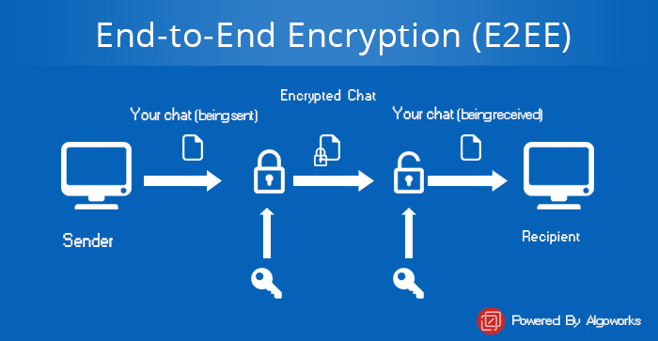
End to end encryption

Slide 27
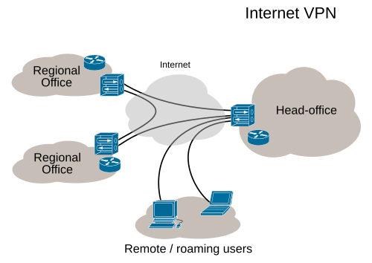
VPN

